Slide 1
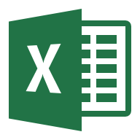
Excel-to-PowerPoint Document Automation
Automatically updates PowerPoint content (text, tables, bullet lists, and charts) based on Excel data and analysis
This Document contains a simple example to demonstrate how the AnalysisPlace “Excel-to-PowerPoint Document Automation” Add-in works. It also contains basic instructions on how to use the add-in to update and link content.
The Excel-to-Word and Excel-to-PowerPoint Document Automation Add-in automates updating of Excel-based content into Word and PowerPoint documents. Updatable content includes text, tables, and charts. It also makes it easy to link/map the “dynamic” content to be updated.

Slide 2
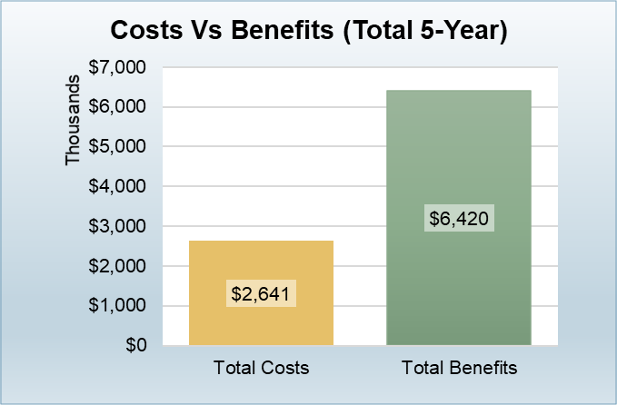
Sample Dynamic Content
Content on this slide will be updated based on the data submitted from Excel when you click “Update Document” on the Update tab.
Personalized for:
This text will be updated based on the “rpt_CustomerName” cell in Excel
Name will appear here
This text will be updated based on “rpt_TextSummary” cell in Excel
Summary of results text will appear here.
Features Included in Scope:
Scope list will appear here
When updated, this chart will match the appearance of the Excel chart named “rpt_CostsVsBenefitsChart”
This bullet list will be updated based on the “rpt_ScopeList” cell in Excel

Slide 3
Sample Dynamic Content
Content on this slide will be updated based on the data submitted from Excel when you click “Update Document” on the Update tab.
Merchant | Date | Category | Amount
Table
The text in this table will be updated based on the range named “rpt_ROISumTable” in Excel
The text in this table will be updated based on the Table (data table) named “rpt_ExpensesTable_visible” in Excel

Slide 4
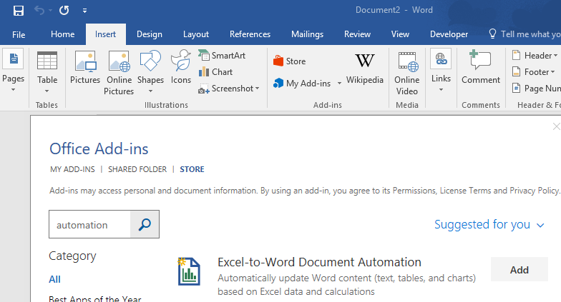
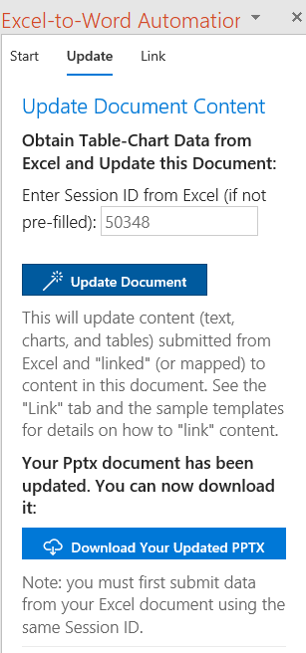
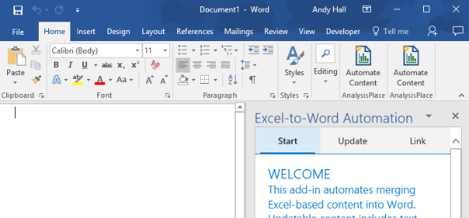
To Get Started To get started, update the sample PowerPoint document from the sample Excel workbook
Install the “Excel-to-Word Document Automation” Add-In in both Excel and PowerPoint (and Word, if desired)
Insert > Add-ins > Store
Search for “Document Automation”. Add it.
Activate it from the Home ribbon
Download the sample Excel and PowerPoint templates (available from within the add-in)
In Excel: modify some tan-colored input cells, then “Submit Content” (from the “Submit” tab of the add-in)
In PowerPoint: “Update Document” from the “Update” tab of the add-in
Download the updated document. You should see the changes.
1
2
D
3
E

Slide 5
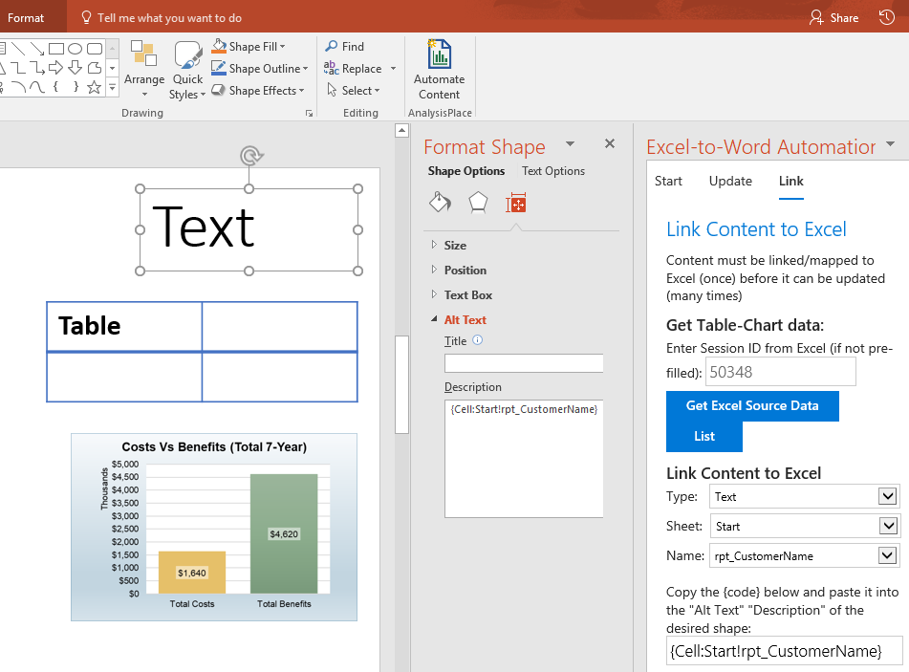
How to Link/Map Content Mapping content between Excel and PowerPoint is easy, but does require some manual steps
In Excel
Name Content (cell, range, or chart)
“Submit” Content
In PowerPoint
Click “Get Excel Source Data” (“Link” tab)
In PowerPoint (for each item/shape)
Select desired Excel source from the drop-downs
Copy the provided {code}, including the brackets
Select (or create) the desired shape
Important: the shape type must match:
Text - Shape can be a title, text box, content shape, WordArt, etc.
Charts/Images - Shape must be an existing image/picture. For example, copy the chart or range from Excel, then paste it in PPT as a picture (TIFF on a Mac). Don't paste chart as the default chart format. With PPT Online: Insert > any Picture or Online Picture.
Tables - Shape must be an existing table (Insert > Table)
Paste {code} into the Shape's “Alt Text” description box
Windows or Mac: Right-click on shape border, choose "Edit Alt Text".
Online: Select shape > Click the Shape
In PowerPoint (to update your document)
On the "Update" tab, click "Update Document". This will upload a copy of your PowerPoint document along with your changes/data from Excel. Our server will then modify the document.
Download your updated document via the “Download” button
6
3
7
4
5

Slide 6
Common Document Automation Scenarios Enables a wide variety of data-intensive document automation scenarios. Here are a few:
Excel Data Consolidation, Calculations, and Analysis | PowerPoint and/or Word Documentation and Presentation
ROI/TCO tools Product selection and solution configuration Product pricing lookups and calculations | Personalized sales and marketing collateral, including proposals and quotes Customer business cases Personalized customer presentations
Project plans and progress | Status reports
Product specifications | Custom product documentation
Assessments (data entry and analysis) | Results reports
Consolidation and analysis of financial data | Recurring financial reports
Engineering/scientific calculations | Custom datasheets
Business data analysis Consolidation of data from ERP, CRM, and other enterprise systems | Recurring business reports

Slide 7
Key Features
Easy/secure download and install via the Microsoft Office Store
One add-in for Excel, Word, and PowerPoint
Single Excel document can update both Word and PowerPoint files
Office for Mac and Office for Windows (Office Online can update only)
Free-forever versions available for evaluation and light use
Content links are durable
Content links between Excel and Word/PowerPoint are durable (can be shared with others and will still update properly)
Links are easy to maintain and update
Linked content can be copy/pasted into other documents

Slide 8
Word Vs. PowerPoint Key Differences
 | Excel-to-Word | Excel-to-PowerPoint
Updatable Content | Charts, Tables, Text | Charts, Tables, Text, Bullet Lists
Content Updating Method | Office Add-In* Your docx is updated | Server** A copy of your pptx is updated
Document Authoring/Linking | Automated Linking Tools | Manual Link Insertion
*Excel content is transferred to Word via a server, then content is updated in Word using the Add-In
**Excel content along with a copy of the entire PPTX document is uploaded to the server where the PPTX is updated then the modified PPTX is downloaded back to the user

Slide 9
For More Information
https://analysisplace.com/Solutions/Document-Automation
Requirements
This add-in requires Office 2016
Microsoft Excel
Excel 2016 for Windows Version 1608 (Build 7369.2055) or later
Excel 2016 for Mac 15.27 or later
Excel Online
Microsoft Word
Word 2016 for Windows Version 1612 (Build 7668.1000) or later
Word 2016 for Mac 15.32 or later
Word Online
Microsoft PowerPoint
PowerPoint 2016 for Windows
PowerPoint 2016 for Mac
PowerPoint Online
Support
Please contact AnalysisPlace for any questions, issues, or suggestions.
https://analysisplace.com/Contact-Us or use the feedback form in the add-in
Other Services
AnalysisPlace offers a variety of related services:
Enterprise licensing
For organizations requiring more than 50 licenses.
For example, this can enable all sales personnel to rapidly create proposals and business cases for customers.
Development of highly effective assessment tools
AnalysisPlace has been developing highly effective/productive assessment tools for over 15 years.
Development/inclusion of advanced/custom features

